Slide 1

Data-Driven Marketing Optimization Using SQL
NOVA BEUTY MARKETING MIX MODELING (MMM) ANALYSIS

Slide 2

AIM OF PROJECT
Understand channel effectiveness & ROI
Quantify seasonal & festive uplift
Optimize marketing budget allocation
Support data-driven decision-making for short-term
campaigns and long-term brand growth

Slide 3

INTRODUCTION
Marketing Mix Modeling (MMM) helps companies see how well their marketing activities are working. It looks at different channels like ads, social media, influencers, and offline campaigns to understand which ones give the best results. This helps companies spend money in the right places.
In this project, we use SQL to manage marketing data and calculate important metrics like Return on Investment (ROI). ROI shows how much profit a campaign brings compared to the money spent. By knowing ROI, companies can focus on campaigns that work well and improve overall marketing performance.

Slide 4

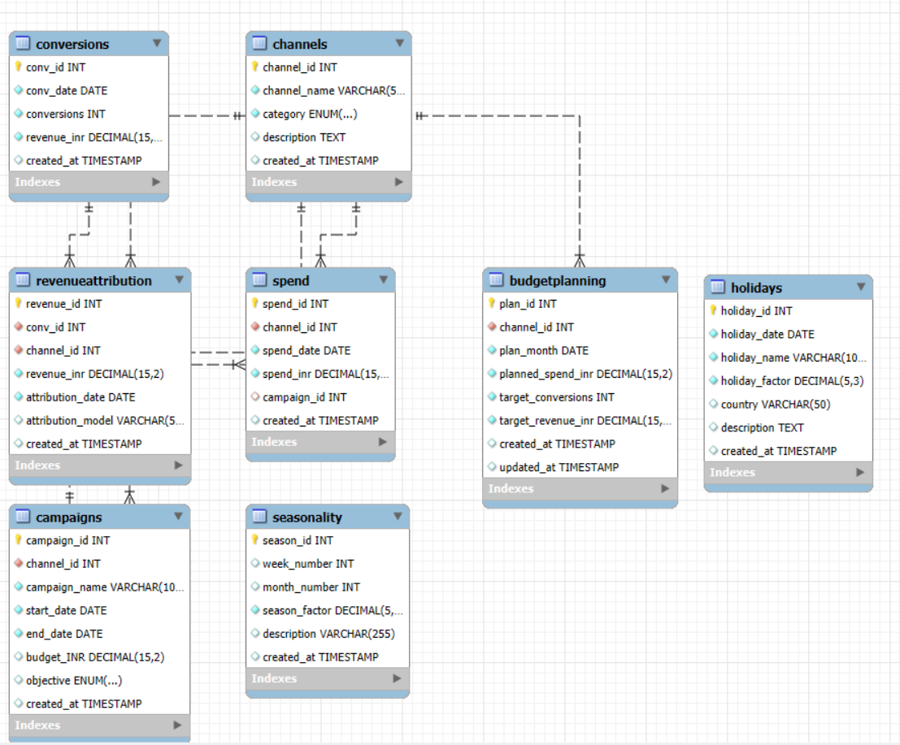
ENTITY RELATIONSHIP DIAGRAM

Slide 5
Channels
Campaigns
Spend
Conversions
Seasonality
Holidays
Revenue Attribution
Budget Planning
TABLES IN PROJECT

Slide 6

DDL (Data Definition Language)

Slide 7

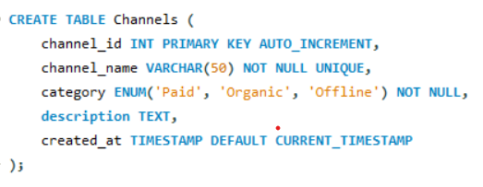
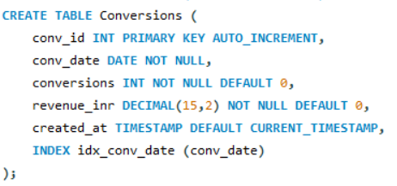
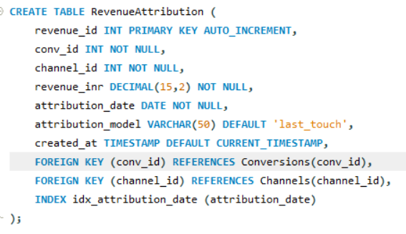
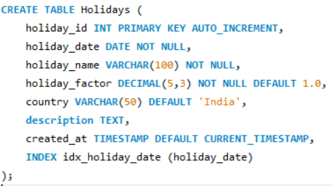
TABLES
CHANNELS
Conversions
Revenue Attribution
Holidays

Slide 8

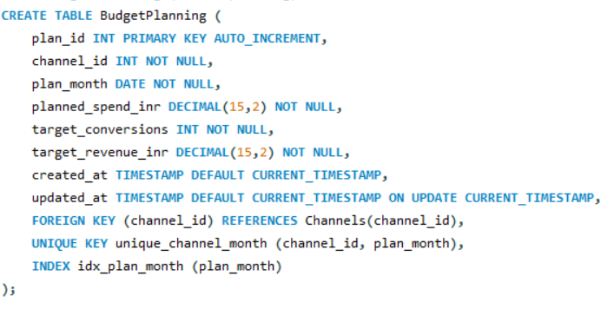
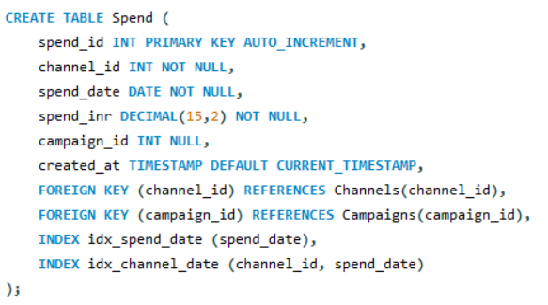
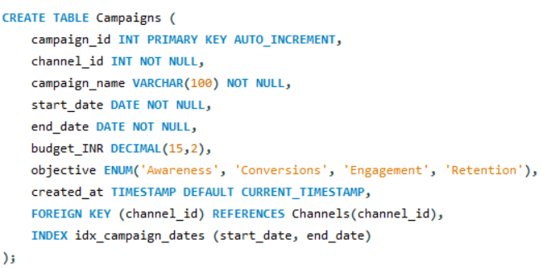
Budget Planning
Spend
Campaigns

Slide 9
DML (Data Manipulation Language)

Slide 10

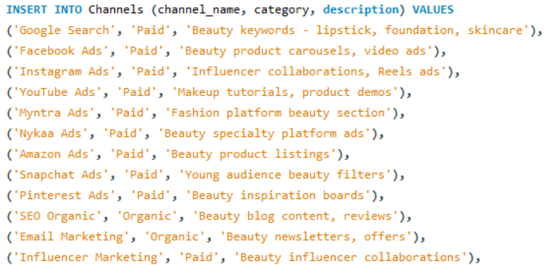
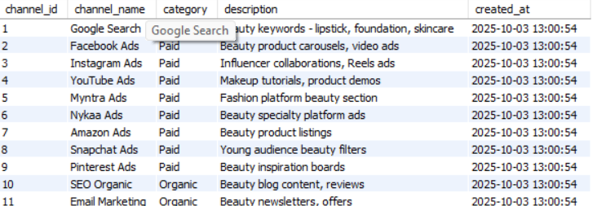
INSERTING
In CHANNELS table

Slide 11
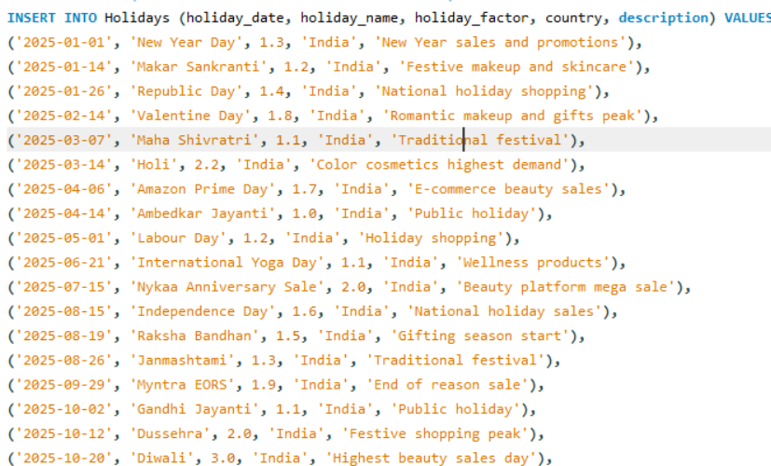
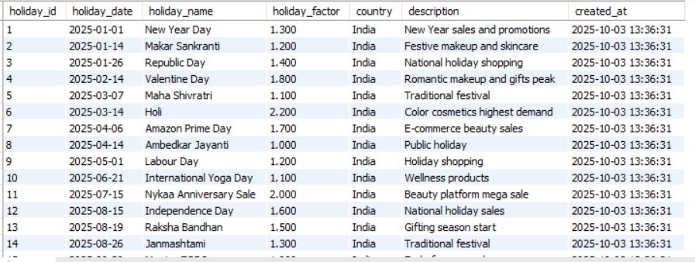
In HOLIDAYS table

Slide 12
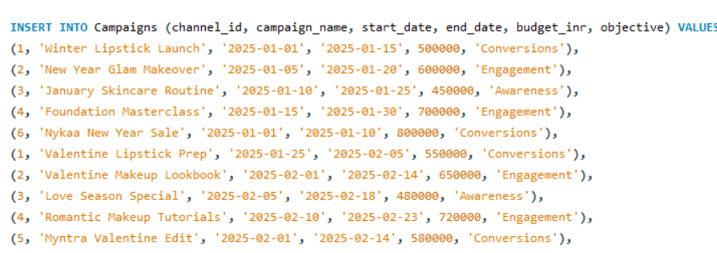
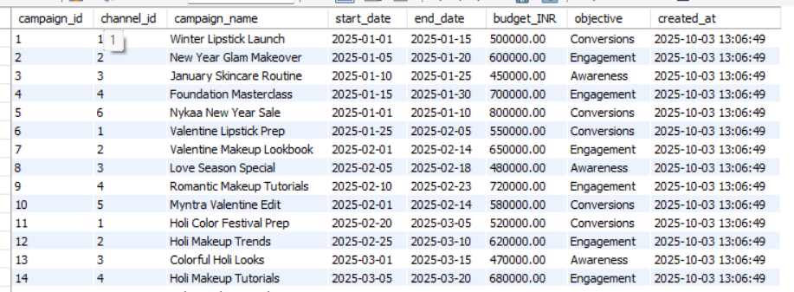
In CAMPAIGNS table

Slide 13
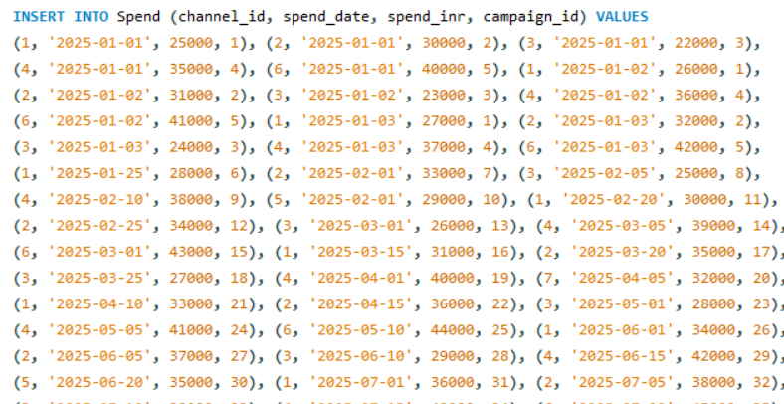
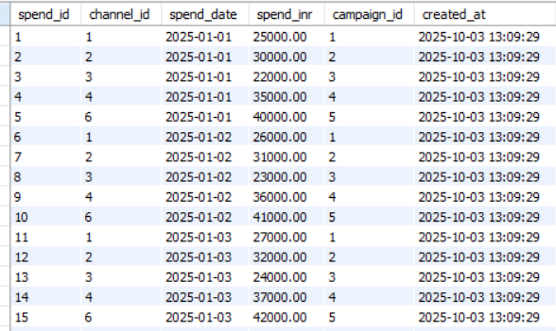
in Spend table

Slide 14
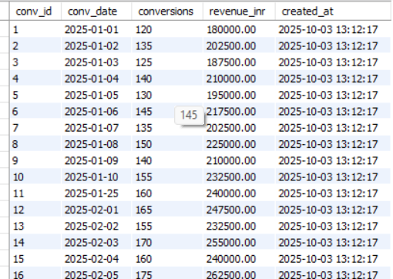
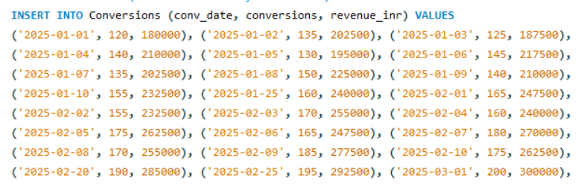
In CONVERSIONS table

Slide 15
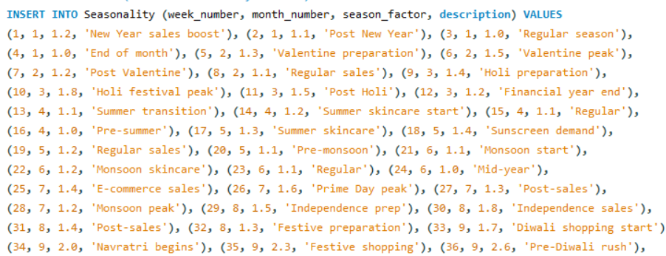
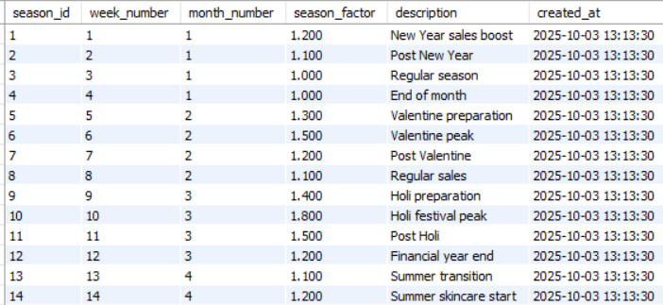
In SEASONALITY table

Slide 16
Data Aggregation & Analysis

Slide 17

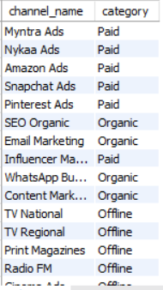

List all marketing channels and their types (Paid / Organic / Offline).

Slide 18

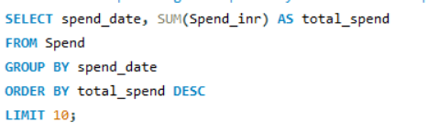
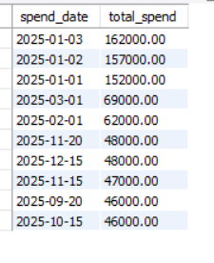
Show the top 10 highest-spend days across all campaigns

Slide 19
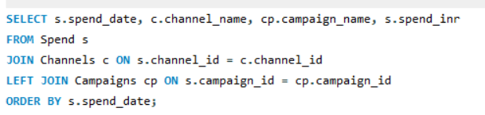
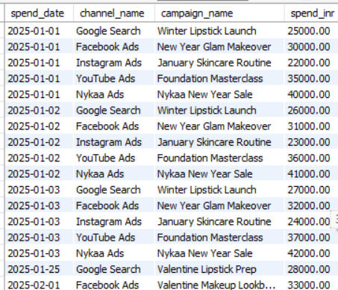
Show daily spend with campaign name and channel

Slide 20
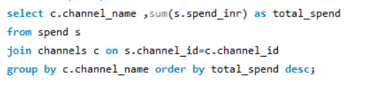
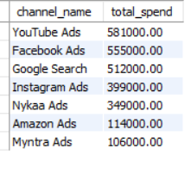
total spend per channel

Slide 21
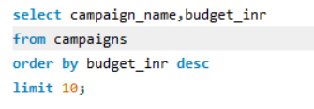
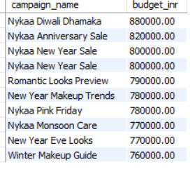
top 5 campaigns by budgets

Slide 22
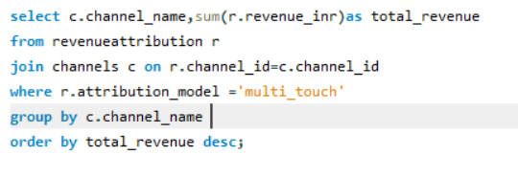
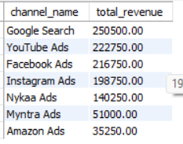
revenue generated per channel

Slide 23
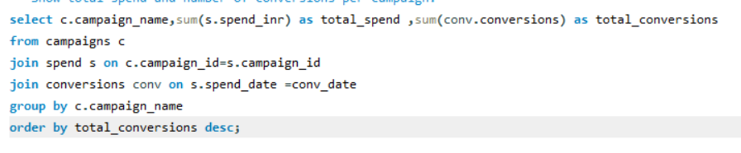
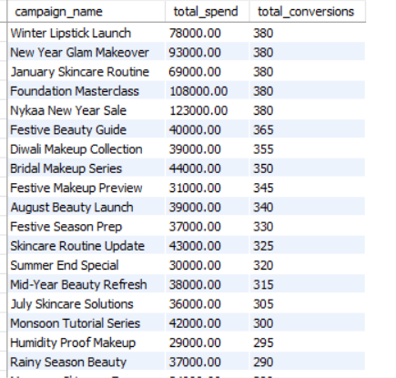
Show total spend and number of conversions per campaign.

Slide 24
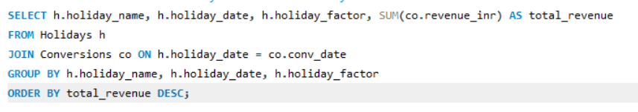
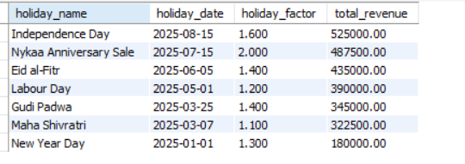
Show total revenue on holidays with their holiday factor.

Slide 25
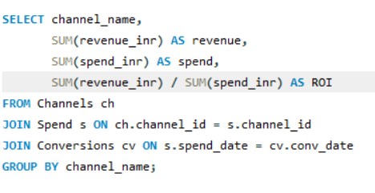
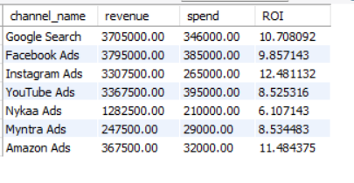
Calculate ROI per channel (Revenue / Spend).

Slide 26
THANK YOU..

